Slide 1



GAME ANALYSIS
By: Ruth Omolara Ajagunna
Date: 16/4/2024

Slide 2

INTRODUCTION
The goal of the "Game Analysis" Project is to gather meaningful information from player data in order to improve player engagement and optimize game performance. Understanding player behavior and preferences is crucial in providing exceptional gaming experiences.
Business Task: The business task involves analyzing player data to understand their behavior, preferences, and performance. It goals include finding top-performing players based on total scores, comparing scores across different segments, and identifying any outliers or significant observations that may impact game development and player engagement strategies.

Slide 3


DATA SOURCES
The "Game Analysis" project used datasets from Mentorness Data Analysis Internship. These publicly available and trusted datasets provide insights into player behavior and game performance.
Dataset: Player_Details
Contains information about players, including their Player ID, Name, Level Status, and Codes.
Level_Details: Summarizes game-related data for each level, including Player ID, Developer ID, Start Time, Stages Crossed, Difficulty, Kills/Headshots, Score, and Lives Earned.

Slide 4


CLEANING AND MANIPULATION
Player Details Dataset:
Modified L1_Status and L2_Status columns to varchar(30).
Changed the data type of P_ID to int and set it as the primary key.
Dropped unnecessary column myunknowncolumn.
Level Details Dataset:
Dropped unnecessary column myunknowncolumn.
Renamed and changed the data type of timestamp to start_datetime (datetime).
Modified data type of Dev_ID and Difficulty.
Added composite primary key (P_ID, Dev_id, start_datetime).
These data cleaning and manipulation steps were executed using SQL commands, enhancing data structure and integrity for analysis

Slide 5

SUMMARY OF DATA ANALYSIS
Steps Used:
Data Cleaning: Modified types, dropped unnecessary columns.
Aggregation: Calculated total scores using SUM() function.
Comparison: Analyzed player metrics across game and difficulty levels.
Visualization: Created bar and line charts for representation.
Metrics and Functions:
Total Scores: Calculated with SUM() on score.
Player Performance: Analyzed kill count, headshots, lives.
Game Level Comparison: Compared scores across levels.
Difficulty Comparison: Analyzed performance by difficulty.
Visualization: Used bar charts for scores, line charts for trends.
Columns Analyzed:
P_ID: Player ID.
score, kill_count, headshots_count, lives_earned: Performance metrics.
Level, Difficulty: Game attributes.
start_datetime: Timestamp data for time analysis.

Slide 6


KEY VISUALIZATIONS AND FINDINGS

Slide 7

KEY VISUALIZATIONS AND FINDINGS

Slide 8

KEY VISUALIZATIONS AND FINDINGS

Slide 9

KEY VISUALIZATIONS AND FINDINGS

Slide 10
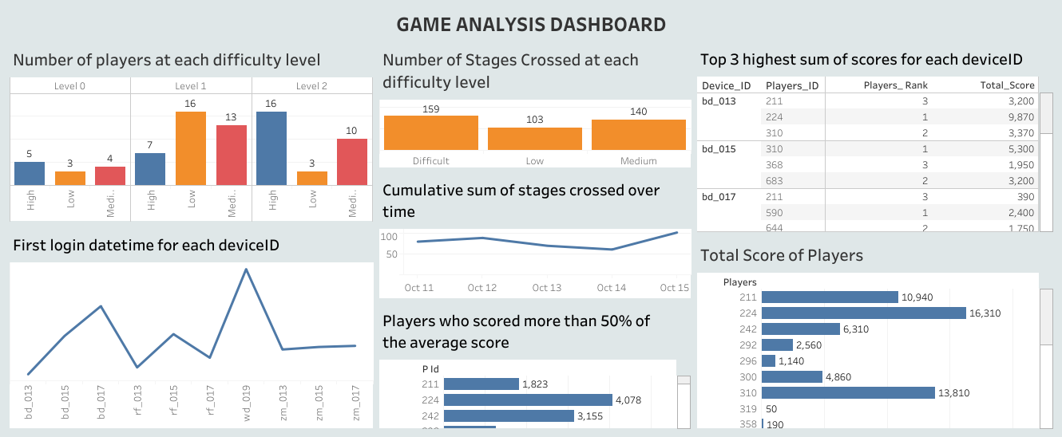

DASHBOARD

Slide 11

RECOMMENDATION
Use player insights and level comparisons to optimize gameplay balance. Increase engagement with targeted strategies and social features. Continuously refine the game through iterative improvements. Explore monetization opportunities through personalized content. Improve player retention and gather feedback from community-building initiatives.

